Slide 1
Minimizing Unnecessary Testing
EZMSA

Slide 2
Background
Budgetary situation
Vitamin D
Other Examples
How can PPEC help?

Slide 3
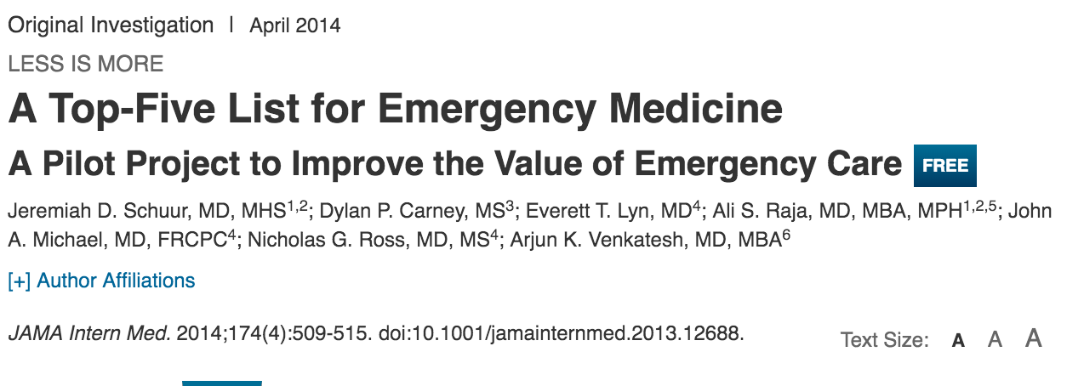
Example: Coagulation Studies
Common Scenarios in which Routine coagulation studies are unnecessary:
ED Chest pain patients
Pre-op testing
“Bundling of PTT/INR”
Notes:
Review this article and discuss coag testing

Slide 4
Intervention
Remove Preselected PTT/INR from EDRN Cardiac Chest Pain Protocol* only
Provide clinical guidance to RN’s
Send coagulation studies if patient is on coumadin/warfarin, has liver disease or a bleeding disorder
RN/Physician Engagement
Educational Rollout targeting nurses and physician
Pre-Post Intervention study design (90d pre, 90d post)

Slide 5
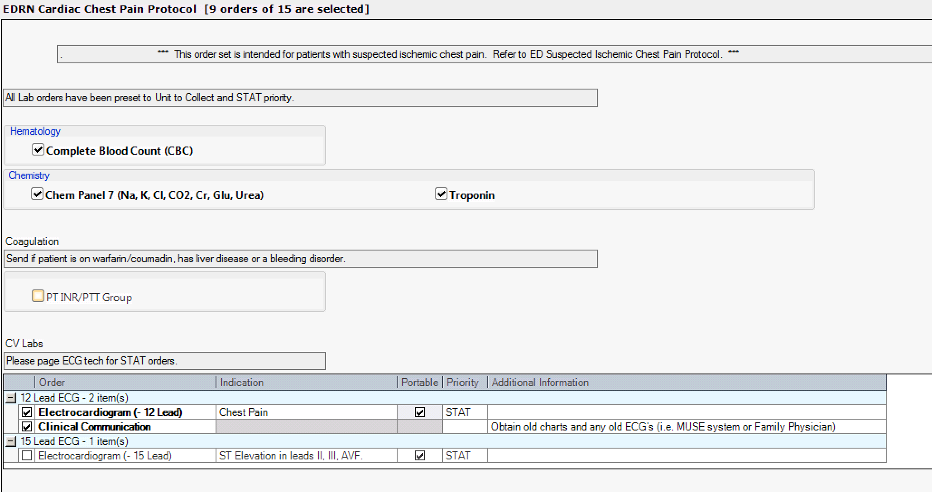
Order Set Change

Slide 6
Results – 90 days pre/post
 | # of INR/PTT’s from EDRN SCCP Order Set
Pre-Intervention | 4982
Post-Intervention | 776
Reduction in INR and PTT’s | -4206 (84% reduction) (8412 fewer tests)

Slide 7
Why this project succeeded?
Passive Intervention (from a Clinician’s perspective)
Physician/RN Engagement
Intervention aligned with evidence and clinicians experience
Departmental support (RN and MD’s)

Slide 8
Laboratory Medicine Initiatives
Item | Opportunity | Lead/ Partner | Date | Cost in 2015/2016 | Potential Savings Estimates
Fetal Fibronectin | Discontinuation of Fetal Fibronectin Testing | Maternal Newborn Child & Youth SCN | July 01, 2016 testing discontinued. | TBD | TBD
General | KT re: costs of lab tests and blood products, as well as duplicated redundant lab tests. | Dr. James Wesenberg/ Dr. Chris Naugler | 2016-2017 Lab Service Plan Appropriateness of Care Initiative | TBD | 1% overall reduction in testing, up to $500K / year
General | Support to blood utilization initiatives in Alberta including support to the SCNs, Alberta Blood Office and the TM Network. | Dr. James Wesenberg/ Dr. Chris Naugler | 2016-2017 Lab Service Plan Appropriateness of Care Initiative | TBD | $3M per year as estimated by SCNs
B12 Testing | Intervention to reduce B12 testing. | Dr. Chris Naugler | 2016-2017 Lab Service Plan | TBD | $500K / year
Urine Cultures | reduce unnecessary urine cultures. | Dr. Chris Naugler Antimicrobrial Stewardship Alignment | 2016-2017 Lab Service Plan Appropriateness of Care Initiative | TBD | $1.5M / year

Slide 9
Laboratory Medicine Initiatives
Item | Opportunity | Lead/ Partner | Date | Cost in 2015/2016 | Potential Savings Estimates
Unnecessary Testing Groups | TSH/FT4 GGT/ALK PHOS ESR/CRP Amylase/Lipase CKMB/Troponin | Dr. Carolyn O’Hara/DynaLifeDx | TBD | TBD | TBD
Top Misused Tests | Allergy Testing Folate B12 Chloride/CO2 Thyroid testing ANA testing ESR Liver “panels” ATTG HbA1c | Dr. Carolyn O’Hara/DynaLifeDx | TBD | TBD | TBD
Type & Screen | Discontinuing routine practices of Type and Screen for low risk C/S | Maternal Newborn Child & Youth SCN | TBD | TBD | TBD
PT, PTT and INR | PT, PTT and INR is being drawn in nursing protocols that are not necessary | Emergency Strategic Clinical Network (ESCN) | TBD | TBD | TBD

Slide 10
Other Proposed Interventions
 | Process | Process | Estimated Savings
Low Molecular Weight Heparins (LMWHs) | Tendering | Change Management/Clinical Protocols | ~-$850K - >$1M
Albumin Use Reduction in ICU |  | Change Management/Clinical Protocols | ~$275K/annum
Appropriate use of PET imaging | Limit Ordering | Change Management/Clinical Protocols | ?
Appropriate Use of CT Scan | ED Cancer Control | Clinical Protocol Development | Reduce variability

Slide 11
CT Volume: 2011/12 – 2015/16

Slide 12
# of Patients on Waitlist

Slide 13
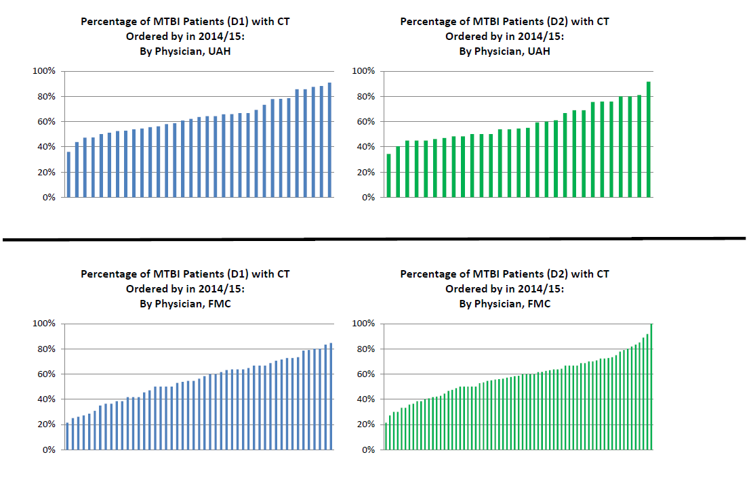
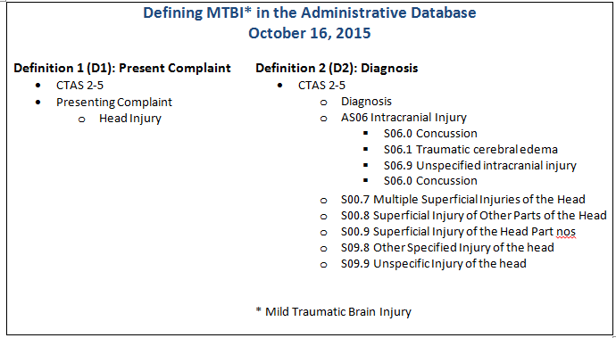
Variation in CT Ordering for MTBI by Physician (Comparing Foothills Medical Centre and University of Alberta Hospital)

Slide 14
Questions for EZMSA
How can Zone leadership and Medical Staff Associations:
Add to potential cost savings initiatives
Support proposed cost savings initiatives
Metrics to measure progress

